Slide 1
Midterm project presentation
Group Member :
黃彥鈞、黃顗亘、鄭宇雅、廖容毅

Slide 2
Outlines
Competition Description
Data Description
Data Cleaning I
First Round ML/DL
Data Cleaning II
Second Round ML/DL
Data Cleaning III
Third Round ML/DL
Next

Slide 3
Why DiaLeval ?
Competition Description
Data Description
Data Cleaning I
First Round ML/DL
Data Cleaning II
Second Round ML/DL
Data Cleaning III
Third Round ML/DL
Next
Dialogue Quality (DQ)
Given a customer-helpdesk dialogue, return an estimated distribution of dialogue quality ratings for the entire dialogue.
NTCIR-15 DialEval-1
Data: Chinese and English
Nugget Detection (ND)
Given a customer-helpdesk dialogue, return an estimated distribution of labels over nugget types (similar to dialogue acts) for each turn.
An effective ND system is useful for building effective helpdesk systems that can self-diagnose at the dialogue turn level to improve themselves.

Slide 4
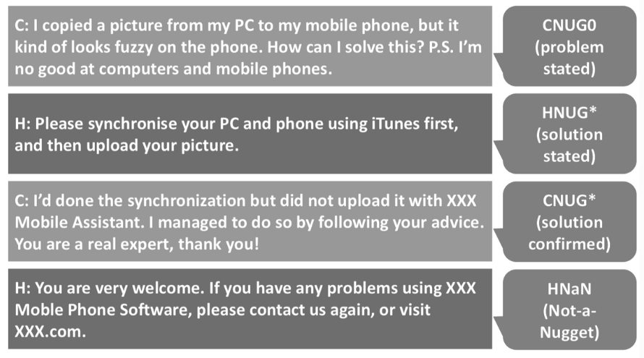

Nugget label Example
Competition Description
Data Description
Data Cleaning I
First Round ML/DL
Data Cleaning II
Second Round ML/DL
Data Cleaning III
Third Round ML/DL
Next
Nugget Labels
CNUG0 | Customer trigger
CNUG* | Customer goal
HNUG* | Helpdesk goal
CNUG | Customer regular nugget
HNUG | Helpdesk regular nugget
CNaN | Customer Not-a-Nugget
HNaN | Helpdesk Not-a-Nugget
Data
annotations
nugget
turns
id
Dial-quality
sender
utterances
There’s 19 Annotators, so every utterance should have 19 labels.
19 Annotators
4090 cases :
Train 3700
Dev 390

Slide 5
Maxing labels
Competition Description
Data Description
Data Cleaning I
First Round ML/DL
Data Cleaning II
Second Round ML/DL
Data Cleaning III
Third Round ML/DL
Next
Since there’s 19 labels for each utterance, we first counted the maximum nugget for each utterance (donated as max_nugget) that simplifying the multi-labels_multi_classification into an single-labels_multiple-classification issue.
Generate Maximum label : CNaN
As a new column.
19 Nuggets
(labels)
Maximum the nugget
1 Nugget
(labels)
For each utterance (sentence)

Slide 6
multiple-classification I
Competition Description
Data Description
Data Cleaning I
First Round ML/DL
Data Cleaning II
Second Round ML/DL
Data Cleaning III
Third Round ML/DL
Next
ML: tfidf
DL: word embedding
Input utterance(text), predict max_nugget, the top 3 method :
SVC
precision recall f1-score support
0 0.69 0.87 0.77 477
1 0.67 0.17 0.28 23
2 0.87 0.96 0.91 374
3 0.25 0.03 0.05 101
4 0.87 0.91 0.89 662
5 0.00 0.00 0.00 33
6 0.74 0.24 0.36 85
accuracy 0.80 1755
macro avg 0.58 0.45 0.47 1755
weighted avg 0.76 0.80 0.76 1755
LogisticRegression
precision recall f1-score support
0 0.68 0.88 0.77 477
1 0.75 0.13 0.22 23
2 0.87 0.95 0.91 374
3 0.22 0.02 0.04 101
4 0.87 0.91 0.89 662
5 0.33 0.03 0.06 33
6 0.86 0.22 0.36 85
accuracy 0.80 1755
macro avg 0.66 0.45 0.46 1755
weighted avg 0.77 0.80 0.76 1755
BERT
precision recall f1-score support
0 0.75 0.75 0.75 477
1 0.69 0.39 0.50 23
2 0.82 0.93 0.87 374
3 0.44 0.15 0.22 101
4 0.84 0.94 0.89 662
5 0.00 0.00 0.00 33
6 0.55 0.42 0.48 85
accuracy 0.79 1755
macro avg 0.59 0.51 0.53 1755
weighted avg 0.76 0.79 0.77 1755

Slide 7


Adding sender and order INFO
Competition Description
Data Description
Data Cleaning I
First Round ML/DL
Data Cleaning II
Second Round ML/DL
Data Cleaning III
Third Round ML/DL
Comparison
Case 1
Case 2
order
sender
utterance
max_nugget
1
Question statement
CNUG0
2
Solution_1
HNUG
Case 3
3
Confirmation
CNUG

Slide 8
multiple-classification II
Competition Description
Data Description
Data Cleaning I
First Round ML/DL
Data Cleaning II
Second Round ML/DL
Data Cleaning III
Third Round ML/DL
Next
ML: tfidf (decomposition) concatenate sender and round
DL: word embedding layer + sub layer (sender, round)
Input sender, round and utterance(text), predict max_nugget, the top 3 method :
BERT
precision recall f1-score support
0 0.86 0.97 0.91 477
1 0.60 0.39 0.47 23
2 0.97 0.99 0.98 374
3 0.66 0.27 0.38 101
4 0.91 0.96 0.93 662
5 0.13 0.06 0.08 33
6 0.77 0.59 0.67 85
accuracy 0.89 1755
macro avg 0.70 0.60 0.63 1755
weighted avg 0.87 0.89 0.87 1755
RandomForest
precision recall f1-score support
0 0.82 0.98 0.90 477
1 0.29 0.09 0.13 23
2 0.95 0.99 0.97 374
3 0.57 0.04 0.07 101
4 0.89 0.99 0.94 662
5 1.00 0.03 0.06 33
6 0.90 0.41 0.56 85
accuracy 0.88 1755
macro avg 0.77 0.51 0.52 1755
weighted avg 0.86 0.88 0.84 1755
LogisticRegression
precision recall f1-score support
0 0.83 0.96 0.89 477
1 0.33 0.26 0.29 23
2 0.95 0.99 0.97 374
3 0.30 0.03 0.05 101
4 0.88 0.99 0.93 662
5 0.50 0.03 0.06 33
6 0.88 0.27 0.41 85
accuracy 0.87 1755
macro avg 0.67 0.51 0.52 1755
weighted avg 0.83 0.87 0.83 1755

Slide 9
Dealing Multi-label problem I
Competition Description
Data Description
Data Cleaning I
First Round ML/DL
Data Cleaning II
Second Round ML/DL
Data Cleaning III
Third Round ML/DL
Next
For the problem statement, our mission is kind of dealing the result of 19 annotations for each utterance(sentence). There is no golden standard.
We apply the ‘problem transformation method’ to subset each unique label(7 nuggets) into 7 files in order to find out for each nugget what is the top model we shall choose. It is similar as changing the multi-label into single-label binary classification.
At the end of learning, we re-combine the result each nugget together to a single dataframe.

Slide 10
Dealing Multi-label problem II
Competition Description
Data Description
Data Cleaning I
First Round ML/DL
Data Cleaning II
Second Round ML/DL
Data Cleaning III
Third Round ML/DL
Next
1
2
CNUG0 CNUG* HNUG* CNUG HNUG CNaN HNaN
round
sender
utterance
1
0
0
1
0
1
0
3
File_CNUG0
File_CNUG*
round
sender
utterance
1
round
sender
utterance
0
File_HNUG*
File_CNUG
File_HNUG
round
sender
utterance
0
round
sender
utterance
0
Calculate similarity
File_CNaN
File_HNaN
5
4
Predict the label and recombine them together
Input those file into models respectively
and find out best model for each file

Slide 11
Best model for each nuggeT
Competition Description
Data Description
Data Cleaning I
First Round ML/DL
Data Cleaning II
Second Round ML/DL
Data Cleaning III
Third Round ML/DL
Next
10 fold
Train / Dev
Nugget | Best Model
CNUG0 | XGB
CNUG* | LR / XGB
HNUG* | XGB
CNUG | LR
HNUG | -
CNaN | -
HNaN | -
Nugget | Best Model
CNUG0 | textCNN
CNUG* | SVM
HNUG* | LSTM
CNUG | LSTM
HNUG | textCNN
CNaN | textCNN
HNaN | textCNN

Slide 12
On the progress now
Competition Description
Data Description
Data Cleaning I
First Round ML/DL
Data Cleaning II
Second Round ML/DL
Data Cleaning III
Third Round ML/DL
Next
Seq2seq method building
Similarity Calculation

